Slide 1
Quantum Computers
Gates, circuits and programming

Slide 2
Quantum gates

Slide 3
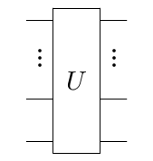
Quantum gates
The same way
classical gates manipulate only a few bits at a time,
quantum gates manipulate only a few qubits at a time
  Usually represented as unitary matrices we already saw
Circuit representation
…boxes and different symbols depict operations on qubits
Wires depict qubits
…inheritence of classical computing –
it is better to think of qubits as particles
and gates as physical processes applied to those particles

Slide 4
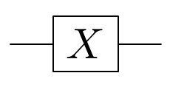








Pauli-X gate
Acts on a single qubit
  Acting on pure states becomes a classical NOT gate
Dirac notation
Matrix representation
Circuit representation
Dirac notation…
…is obviously more convenient for calculus

Slide 5


Pauli-X gate
  Acting on a general qubit state
  It is its own inverse

Slide 6

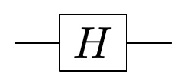


Hadamard gate
Acts on a single qubit
  Corresponding to the Hadamard transform we already saw
  One of the most important gates for quantum computing
Dirac notation
Unitary matrix
Circuit representation
…obviously, no classical equivalent

Slide 7



Hadamard gate
An interesting example
Acting on pure states…
…gives a balanced superposition…
…both states, if measured,
give either 0 or 1 with equal probability

Slide 8




Hadamard gate
  Applying another Hadamard gate
    to the first result
    to the second result

Slide 9


Hadamard gate
The example gives an answer to the question asked before –
why state of the system
has to be specified with complex amplitudes
and cannot be specified with probabilities only
Both states give equal probabilities when measured…
…but when Hadamard transformation is applied
it produces two different states

Slide 10
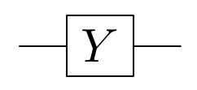


Pauli-Y gate
Acts on a single qubit
Dirac notation
Matrix representation
Circuit representation
…another gate with no classical equivalent

Slide 11
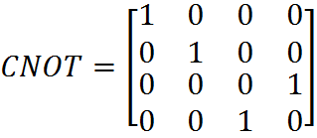
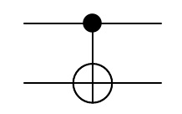

CNOT gate
Controlled NOT gate
Acts on two qubits
  Classical gate operation
Matrix representation
Circuit representation

Slide 12


CNOT gate
  Example of acting on a superposition

Slide 13
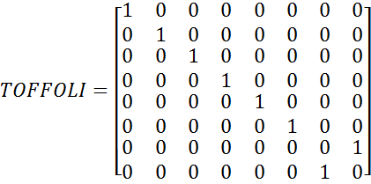
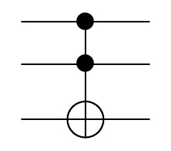
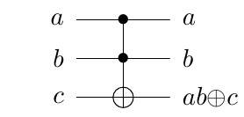
Toffoli gate
Also called Controlled Controlled NOT
Acts on three qubits
  Classical gate operation
Matrix representation
Circuit representation

Slide 14
Quantum circuits

Slide 15
Universal set of quantum gates
There is more than one universal set of gates for classical computing
What about quantum computing, is there a universal set of gates to which any quantum operation possible can be reduced to?

Slide 16
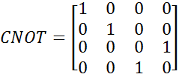



Universal set of quantum gates
No, but any unitary transformation
can be approximated to arbitrary accuracy
using a universal gate set
  For example (H, S, T, CNOT)
Hadamard gate
Phase gate
π/8 gate
CNOT gate

Slide 17
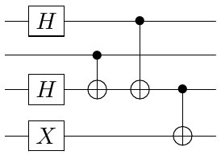
Quantum circuits
The same way
classical gates can be arranged to form a classical circuit,
quantum gates can be arranged to form a quantum circuit
Quantum circuit is the most commonly used model
to describe a quantum algorithm
Unlike classical circuits,
the same number of wires
is going throughout the circuit
…as said before,
inheritence of classical computing –
usually it does not reflect the actual implementation

Slide 18
Quantum programming

Slide 19
Quantum programming
There is already a number of programming languages adapted for quantum computing
  but there is no actual quantum computer for algorithms to be executed on
The purpose of quantum programming languages is to provide a tool for researchers, not a tool for programmers
QCL is an example of such language

Slide 20
Spyder Editor
"""
%matplotlib inline
from qiskit import *
qr = QuantumRegister(2)
cr = ClassicalRegister(2)
circuit = QuantumCircuit(qr, cr)
circuit.draw()
circuit.h(qr[0])
circuit.draw(output='mpl')
circuit.cx(qr[0],qr[1])
circuit.draw(output='mpl')
IBMQ.load_account()
provider = IBMQ.get_provider('ibm-q')
qcomp = provider.get_backiend('ibmq_16_melbourne')
job = execute(circuit, backend=qcomp)
from qiskit.tools.monitor import job_monitor
job_monitor(job)
QiSKIT examle code

Slide 21
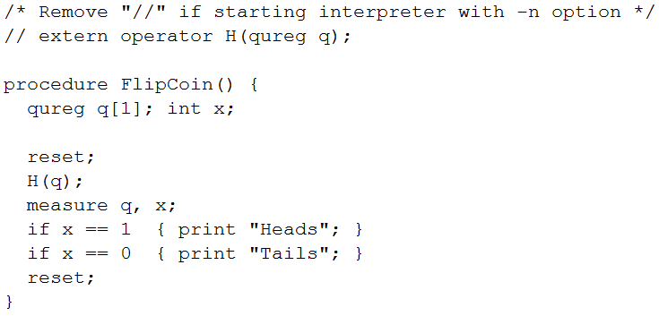
Quantum programming
QCL (Quantum Computation Language)
    http://tph.tuwien.ac.at/~oemer/qcl.html
C-like syntax
allows combining of quantum and
classical code

Slide 22
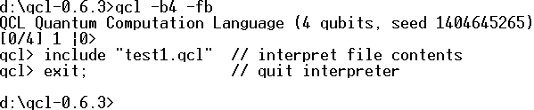
QCL
Comes with its own interpreter and quantum system simulator
Start interpreter…
…with a 4 qubit quantum heap (32 if omitted)
Numeric simulator
Shell environment
…there is no assumption about the quantum computer implementation

Slide 23
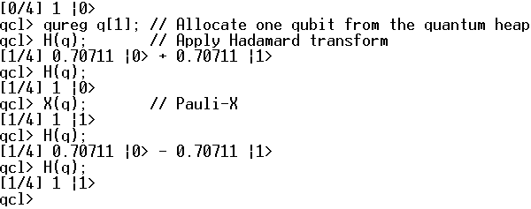
QCL
Example of interpreter interactive use
Initial quantum state
Global quantum register definition
Quantum operator
Resulting state
Qubits allocated/Quantum heap total

Slide 24
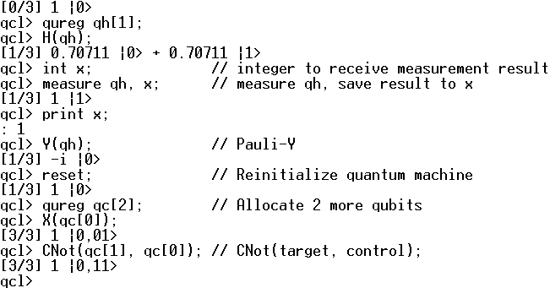
QCL
Example of initialization and measurement within interpreter
Reinitializations have no effect on allocations

Slide 25
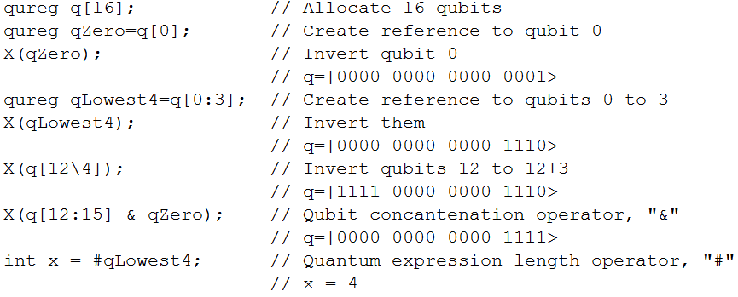
QCL
Examples of quantum registers, expressions and references
Reference definitions have no effect on quantum heap

Slide 26
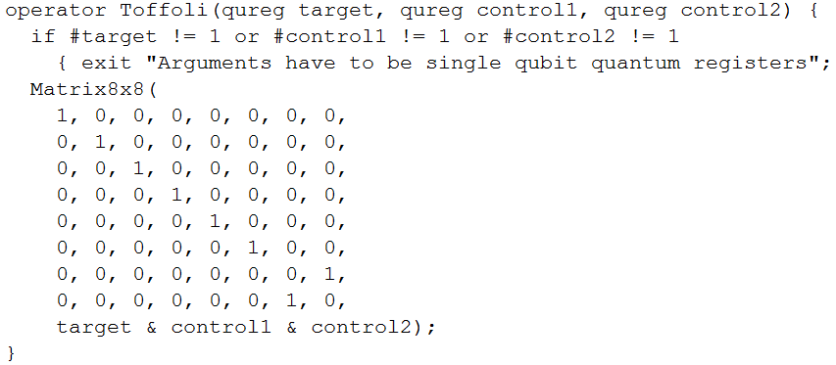
QCL
Example of operator definition

Slide 27
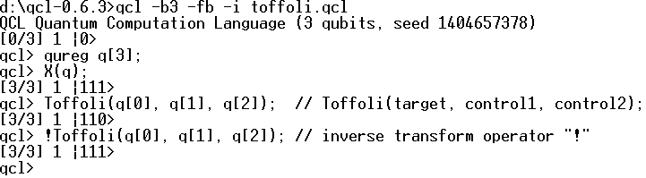
QCL
  Newly defined operator usage
Force interactive use…
…or interpreter will execute file content and exit
Toffoli gate is its own inverse
QCL allows inverse execution

Slide 28
References
University of California, Berkeley,
Qubits and Quantum Measurement and Entanglement, lecture notes,
http://www-inst.eecs.berkeley.edu/~cs191/sp12/
Michael A. Nielsen, Isaac L. Chuang,
Quantum Computation and Quantum Information,
Cambridge University Press, Cambridge, UK, 2010.
Colin P. Williams, Explorations in Quantum Computing, Springer, London, 2011.
Samuel L. Braunstein, Quantum Computation Tutorial, electronic document
University of York, York, UK
Bernhard Ömer, A Procedural Formalism for Quantum Computing, electronic document, Technical University of Vienna, Vienna, Austria, 1998.
Artur Ekert, Patrick Hayden, Hitoshi Inamori,
Basic Concepts in Quantum Computation, electronic document,
Centre for Quantum Computation, University of Oxford, Oxford, UK, 2008.
Wikipedia, the free encyclopedia, 2014.

